Slide 1
Enhanced Cyber Security Monitoring
A SIEM Approach with ELK Stack, Kafka and Wireshark
-Bhavani G
Hemanth
Gopi chand

Slide 2
Contents
Problem Statement
Introduction
Business need
Architecture diagram
Tools
Minimum viable product
Workflow of MVP
Literature review
Implementation
References

Slide 3
Problem statement
We are in a digital age where many organisations are prone to cyber security threats such as data breaches and other malicious activities. It is important to monitor and manage these threats as it is necessary for the organisations to implement security measures to protect their confidential data. So we aim to develop a security information and event management system(siem system) which helps us in better understanding of the network and security and we will be able to detect, analyze and respond to the anomalies and take preemptive measures by identifying the potential weaknesses.

Slide 4
Introduction
The given topic for this capstone project is cyber-apache kafka, elk stack and wireshark. The project is a cyber security project integrating tools such as Apache kafka, ELK stack and Wireshark. The idea behind this project is to understand network security and detect anomalies. In this project we are going to use Apache Kafka to build data pipelines to handle large volumes of data, Wireshark to capture and analyse the network traffic and ELK stack to manage the network traffic data and handle big datasets and complex queries. By combining these tools, we aim to build a SIEM system (Security Information and event management system). SIEM systems are used to detect, analyse and respond to the anomalies or security threats of a network.

Slide 5
Business need
There are many SIEM systems and the popular ones are splunk, IBM QRadar, ArcSight, Microsoft Sentinel and AllenVault(AT&T). The SIEM system is used to help organizations to detect,analyse and respond to the anomalies and also ensure the security policies of the organization are being enforced. With the help of this system we can identify potential weaknesses and take preventive measures.

Slide 6
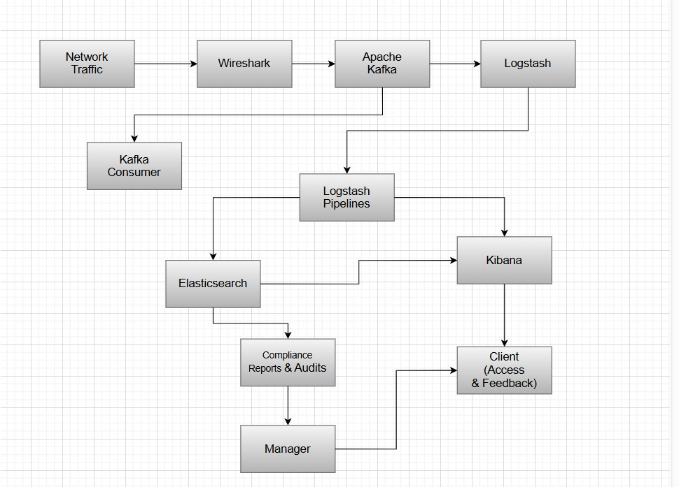
Architecture diagram

Slide 7
Tools
Collab
ELK stack
Logstash
Kafka
Kibana: Create dashboards and visualizations for monitoring and analyzing log data.
Wireshark
Filebeat: Lightweight shipper to collect and forward logs.
Custom Scripts: Automate incident response actions.

Slide 8
Minimum Viable Product (MVP):
To create a Minimum Viable Product (MVP) for the Enhanced Cyber Security Monitoring project, firstly we should focus on developing the core functionalities that are essential for real-time security monitoring, threat detection, and incident response.

Slide 9
Minimum Viable Product (MVP):Contents
Data Collection – Logs are collected from various sources using Logstash and Filebeat, with Kafka handling real-time data streaming for efficient processing.
Data Processing – Logstash pipelines filter, transform, and enrich logs to ensure clean, structured data for indexing and searching.
Data Storage – Processed logs are stored in Elasticsearch indices, enabling scalable storage, quick retrieval, and efficient querying.
Data Analysis & Visualization – Kibana is used to create dashboards and visualizations, allowing security analysts to monitor events, detect anomalies, and gain insights.
Real-Time Alerts & Incident Response – Alerts are configured in Kibana to notify analysts of threats, while automated scripts help in quick incident response actions.

Slide 10
Workflow of MVP
The MVP workflow starts with Data Ingestion, where logs are collected using Logstash and Filebeat, with Kafka handling real-time streaming. In Data Processing, Logstash pipelines filter, transform, and enrich logs to ensure clean, structured data for analysis. Finally, in Data Storage, processed logs are indexed and stored in Elasticsearch, enabling scalable storage, quick retrieval, and efficient querying for real-time analysis.
The Data Analysis and Visualization phase uses Kibana to create dashboards, helping security analysts monitor events, detect anomalies, and gain insights. In the Real-Time Alerts and Incident Response phase, alerting rules in Kibana notify analysts of threats, while automated scripts enhance incident response. This workflow ensures effective security monitoring, threat detection, and incident response, forming a strong foundation for scalability and future improvements.

Slide 11
Literature review
Cybernetics principles, such as feedback loops and adaptive control, enhance SIEM systems for dynamic threat detection and response. Machine learning and AI-driven anomaly detection improve cybersecurity by identifying deviations in network behavior. Integrating frameworks like MITRE ATT&CK and Zero Trust strengthens SIEM solutions against evolving cyber threats.
SIEM systems collect, normalize, and analyze security events in real-time to detect threats and ensure compliance. Modern SIEMs integrate advanced technologies like AI, blockchain, and cloud architectures for improved adaptability and performance. By leveraging machine learning and behavioral analysis, SIEM solutions enhance threat detection, automate responses, and reduce false positives.

Slide 12
Literature Review
The ELK Stack: A Versatile SIEM Component The ELK stack, composed of Elasticsearch, Logstash, and Kibana, has become a robust open-source toolset for SIEM functionalities. Each component plays a distinct role in handling large-scale security event data.
● Elasticsearch: A distributed search and analytics engine that stores, indexes, and retrieves vast amounts of log data in real time. It enhances security monitoring by enabling quick search and retrieval of logs, allowing organizations to detect threats promptly (Poat et al., 2023).
● Logstash: A data processing pipeline that collects, processes, and forwards log data to Elasticsearch. It supports various input sources, making it adaptable for SIEM integration. Logstash helps normalize security event data, ensuring log consistency (Poat et al., 2023).
● Kibana is a visualization tool that provides interactive dashboards, allowing cybersecurity analysts to monitor threats effectively. Its graphical representations make detecting anomalies and analyzing security trends easier (Poat et al., 2023).

Slide 13
Literature Review
Apache Kafka and Wireshark play significant roles in cybersecurity, particularly in data streaming and network traffic analysis:
● Apache Kafka: A distributed event streaming platform for real-time data ingestion and processing. In cybersecurity, Kafka supports log aggregation and enhances SIEM's ability to process large-scale event data efficiently. By enabling real-time event streaming, Kafka helps organizations detect and respond to security threats faster. Kafka also provides scalability, allowing security teams to handle an increasing volume of security events (Shameem et al., 2024).
● Wireshark is a network protocol analyzer widely used for inspecting live network traffic and identifying anomalies such as Distributed Denial-of-Service (DDoS) attacks and malware transmissions. It allows deep packet inspection, enabling cybersecurity professionals to analyze communication between network nodes (Jain & Anubha, 2021).

Slide 14
Literature review
SIEM technologies, combined with open-source tools like ELK, Kafka, and Wireshark, enhance cybersecurity through real-time monitoring and intrusion detection. Cybernetics enables adaptive threat response, while AI and geospatial analytics drive future advancements. Integrating traditional security methods with modern innovations strengthens organizations' cybersecurity frameworks against evolving threats.

Slide 15
implementation
Week 1-2: Project Planning and Setup ● Define objectives and scope ● Set up development environment Week
3-4: Data Collection and Processing ● Configure data collection from various sources ● Set up Logstash pipelines for data processing
Week 5-6: Data Storage and Analysis ● Store processed data in Elasticsearch ● Create initial dashboards in Kibana
Week 7-8: Real-Time Alerts and Incident Response ● Set up alerting rules and notifications ● Develop custom scripts for incident response
Final testing and deployment :
By focusing on these core components and functionalities, the MVP of the project will provide a solid foundation for real-time security monitoring, threat detection, and incident response. As we gather feedback and iterate, we can enhance and expand the system to include additional features and capabilities

Slide 16
References
Ahmed, A., Asim, M., Ullah, I., Zainulabidin, & Ateya, A. A. (2024). An optimized ensemble model with advanced feature selection for network intrusion detection. PeerJ Computer Science, 10, e2472. https://doi.org/10.7717/peerj-cs.2472 Ariffin, M. A. M., Darus, M. Y., Haron, H., Kurniawan, A., Muliono, Y., & Pardomuan, C. R. (2022). Deployment of Honeypot and SIEM Tools for Cyber Security Education Model in UITM. International Journal of Emerging Technologies in Learning, 17(20), 149–172. https://doi.org/10.3991/ijet.v17i20.32901 Calderon, G., del Campo, G., Saavedra, E., & Santamaría, A. (2023). Monitoring Framework for the Performance Evaluation of an IoT Platform with Elasticsearch and Apache Kafka. Information Systems Frontiers. https://doi.org/10.1007/s10796-023-10409-2
More ….

